Slide 1
Online Shopper’s Intention
Final Presentation
Team 3 – 심우석, 이민서, 고효진

Slide 2
TABLE OF CONTENTS
01
04
02
05
03
Objective
Algorithm
Problem Statement &
Business Objective
Classification & clustering algorithm and it’s features
Data Description
Evaluation
Statistical description
of the dataset
Evaluate the results
Preprocessing
Data Preprocessing

Slide 3
01
Objective
Problem statement & Business objective

Slide 4
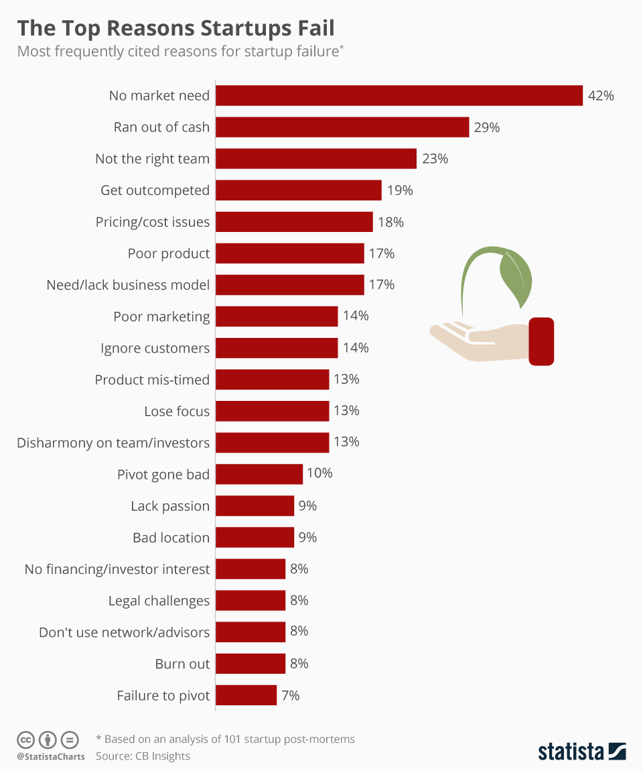
Objective
Due to the nature of online transactions, it is difficult to receive professional consulting because there are many sole proprietorship.
Therefore, it is difficult for them to grasp the demand of the market, and as a result, many businesses fail.
https://www.statista.com/chart/11690/the-top-reasons-startups-fail/

Slide 5
Objective
Due to the nature of online transactions, it is difficult to receive professional consulting because there are many sole proprietorship.
Through this project, The e-commerce company can identify consumer’s behavior patterns and identify factors that affect sales. And based on this, they can lead consumers’ purchases and expand their online business.

Slide 6
02
Data Description
Statistical description
of the dataset

Slide 7
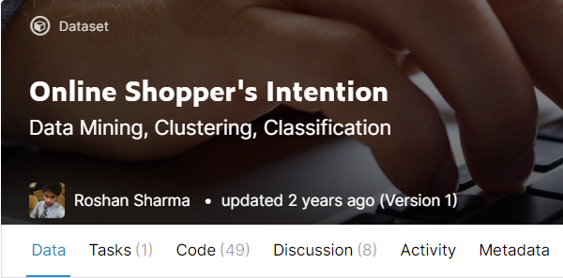
Data Description
Online Shoppers Purchasing Intention Dataset from UCI’s
Kaggle: https://www.kaggle.com/imakash3011/online-shoppers-purchasing-intention-dataset

Slide 8
Online Shopper’s Purchasing Intention
The dataset consists of feature vectors (Rows) belonging to 12,330 sessions.
The dataset was formed so that each session would belong to a different
user in a 1-year period to avoid any tendency to a specific campaign,
special day, user profile, or period.
The dataset consists of 10 numerical and 8 categorical attributes.
Data is 12,330 rows * 18 columns.
The ‘Revenue’ attribute is the class label (target value)

Slide 9
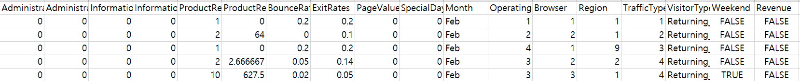
Data Description
Administrative, Administrative Duration, Informational, Informational Duration, Product Related, Product Related Duration, Bounce Rate, Exit Rate, Page Value, Special Day, Browser, Region, Traffic Type, Visitor Type, Weekend, Operating Systems, Month is feature value.
Revenue is target value.
The ratio of target data is 84.5% - False (10,422), True (1908)

Slide 10
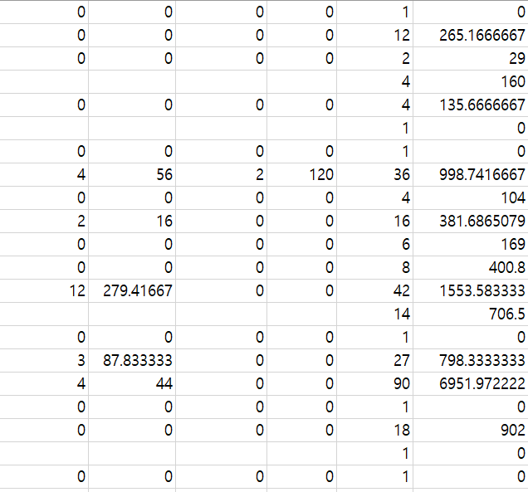
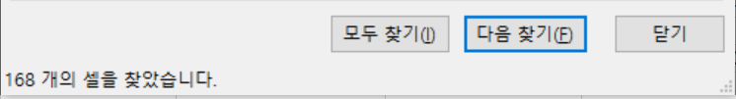
Online Shopper’s Purchasing Intention
Missing value - Administrative, Administrative_Duration,
Informational, Informational_Duration,
ProductRelated, ProductRelated_Duration,
BounceRates, ExitRates. - Total number [168]

Slide 11
Data Description
Feature Name | Data type | Feature Description
Administrative | Integer | Number of different pages visited related to the administrative concerns of the website
Administrative Duration | Integer | Total amount of time (in seconds) spent by the visitor on account management related pages
Informational | Integer | Number of different pages visited related to the information of the website and other useful contents of the website
Informational Duration | Integer | Total amount of time (in seconds) spent by the visitor on informational pages
Product Related | Integer | Number of different pages visited to different products of the website
Product Related Duration | Integer | Total amount of time (in seconds) spent by the visitor on product related pages
Bounce Rate | Float | Average bounce rate value of the pages visited by the visitor
Exit Rate | Float | Average exit rate value of the pages visited by the visitor
Page Value | Float | Page Value is the average value for a page that a user visited before making a transaction
Special Day | Float | The “Special Day” feature indicates the closeness of the site visiting time to a specific special day
Numerical Features -

Slide 12
Data Description
Categorical Features -
Feature Name | Data type | Feature Description
Browser | Integer | ID of browsers from which the session took place.
Region | Integer | ID of regions from which the session took place
Traffic Type | Integer | ID of different types of sources from which the users landed on the website
Visitor Type | String | Visitor type as “New Visitor”, “Returning Visitor” and “Other”
Weekend | Boolean | Whether the session was on a weekend or not
Operating Systems | Integer | Operating system of the visitor
Month | Boolean | Month value of the visit date
Revenue (Target Value) | Boolean | Whether the user contributed to the revenue by purchasing or not

Slide 13
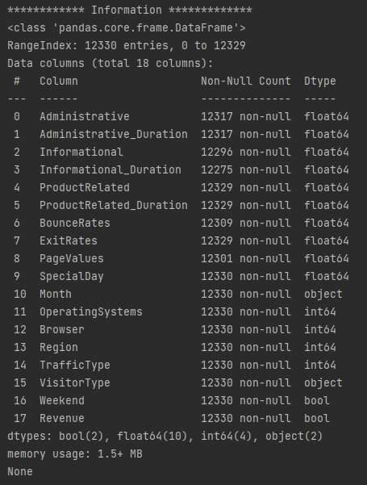
Data Description
Dataset Information -

Slide 14
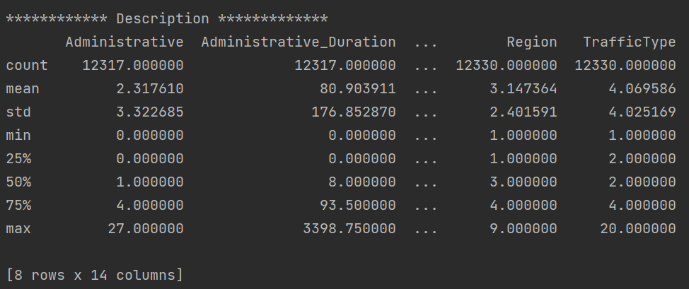
Data Description
Dataset Description -

Slide 15
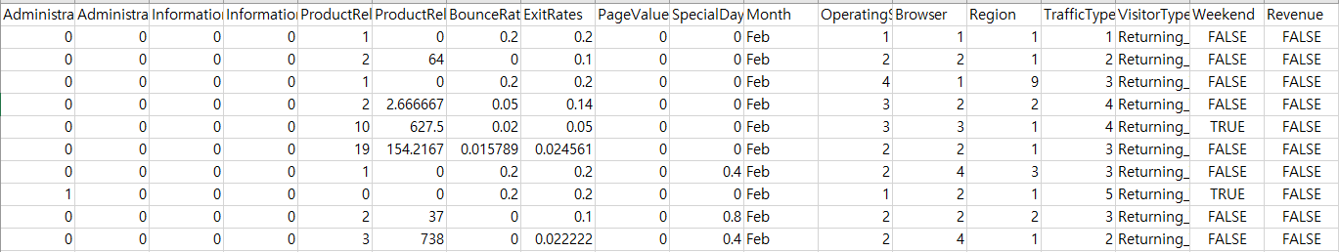
Data Description
Dataset head -

Slide 16
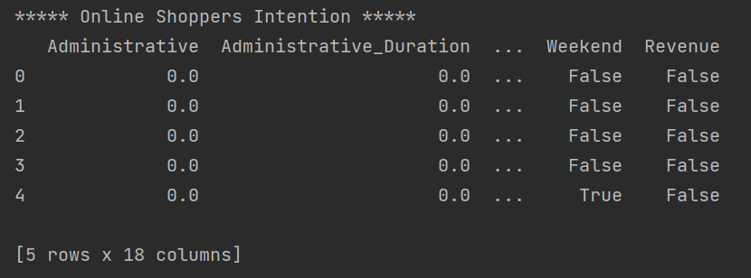
Data Description
Dataset head -

Slide 17
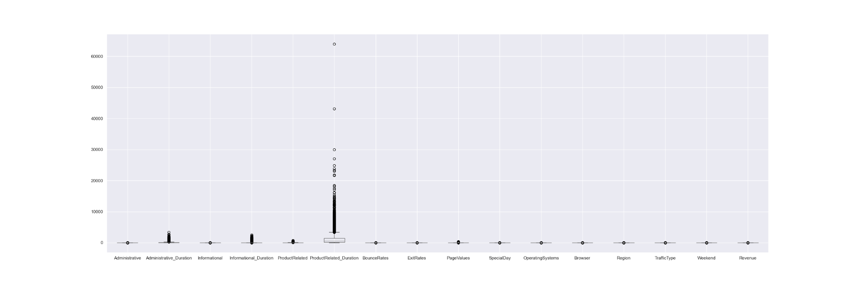
Data Description
Dataset boxplot -

Slide 18
03
Preprocessing
Data Preprocessing

Slide 19
Data Preprocessing
Cleaning Dirty Data -
Missing, Wrong, Unusable Data (Replace it)
2. Outlier detection -
Using the Z-score (numerical)
and Box-plot (categorical)

Slide 20
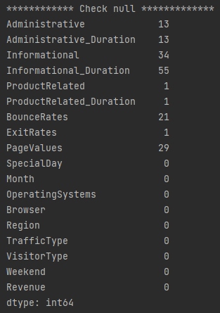
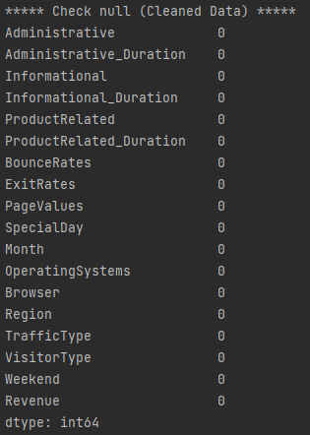
Data Preprocessing
Cleaning Dirty Data -
Missing - Using ffill method

Slide 21
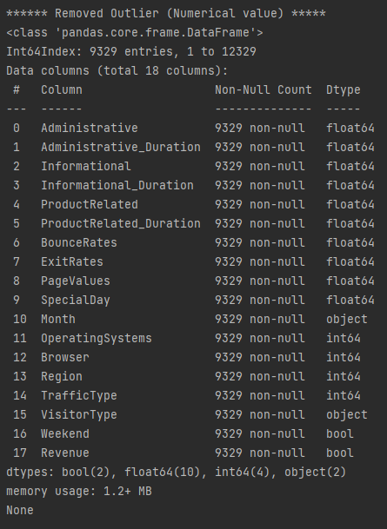
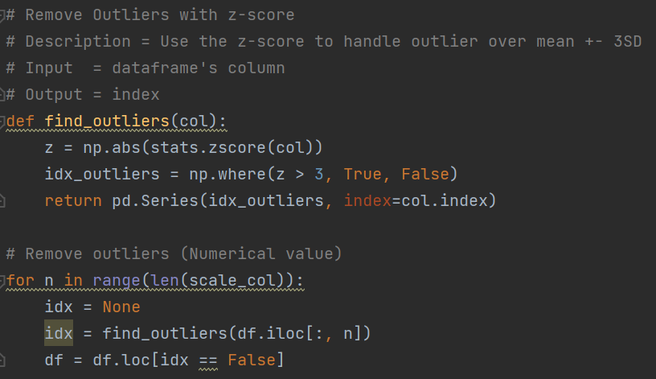
Data Preprocessing
2. Outlier detection -
Using the Z-score (numerical)

Slide 22
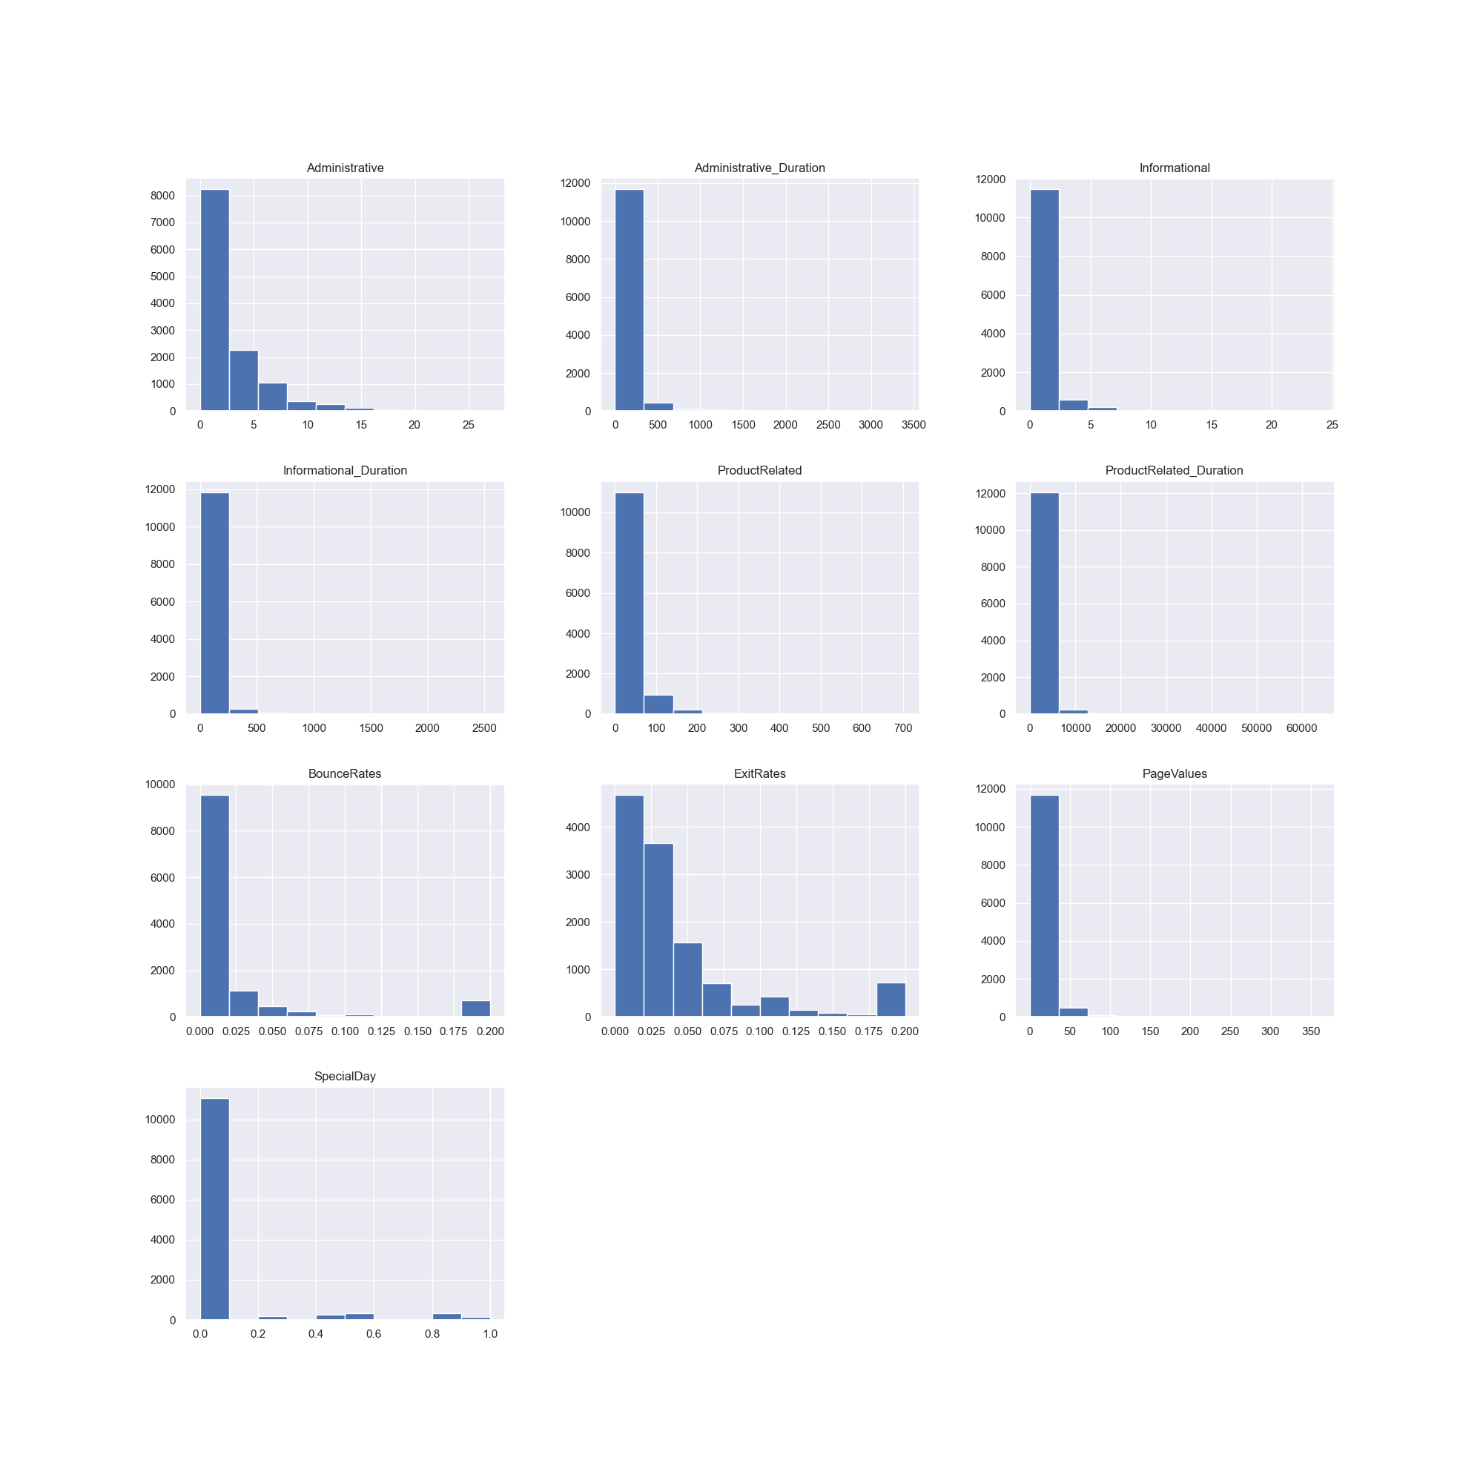
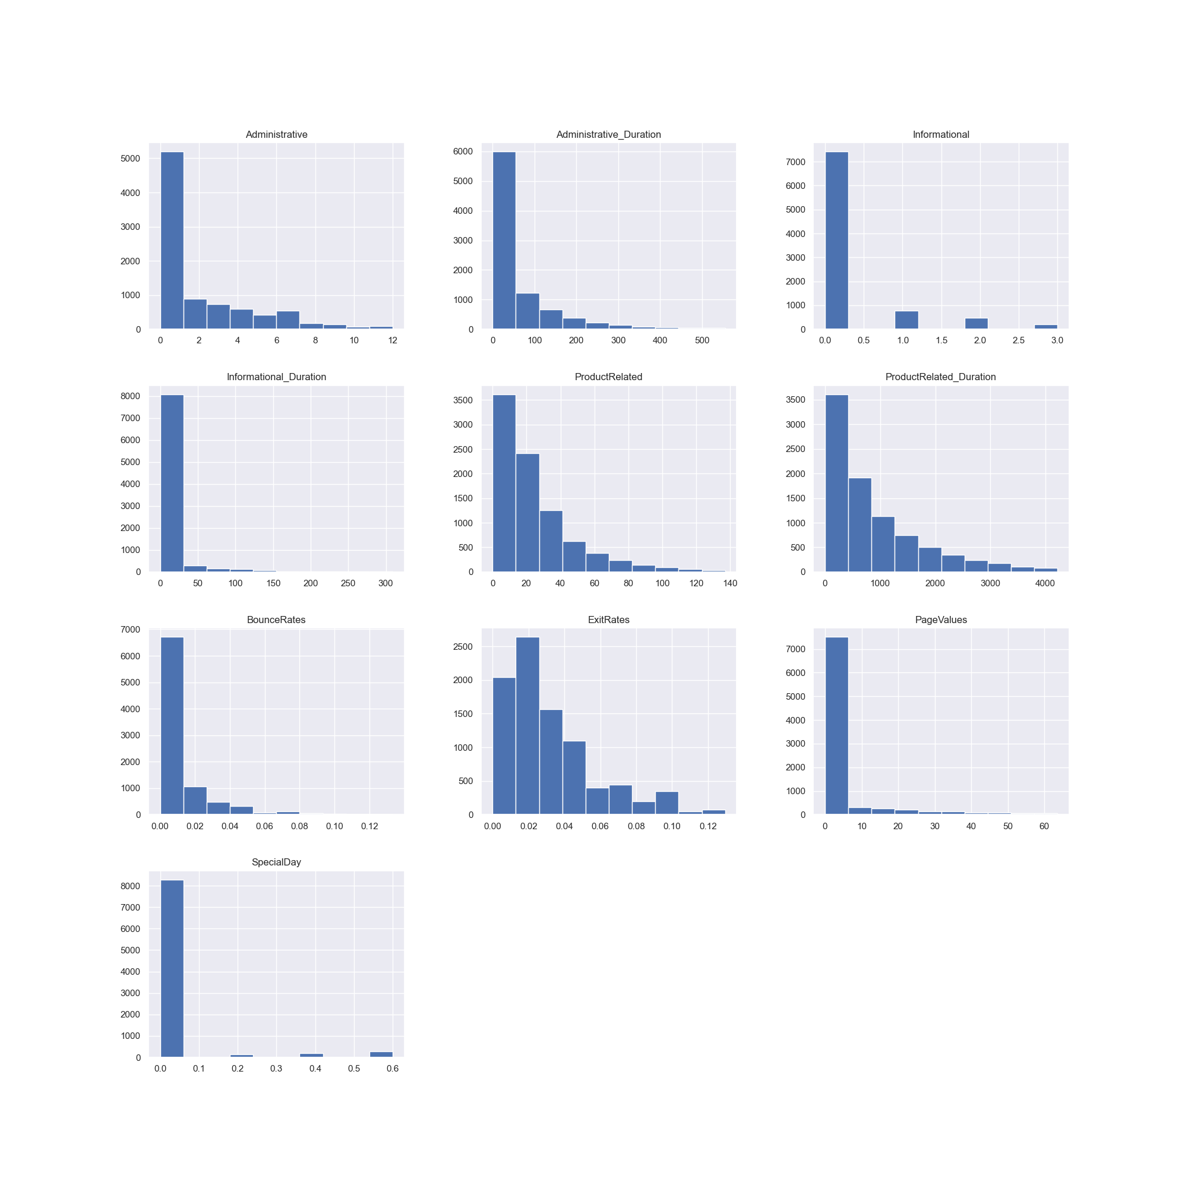
Data Preprocessing
2. Outlier detection -
Using the Z-score (numerical)

Slide 23
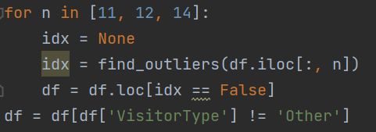
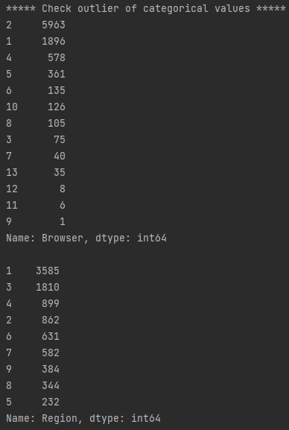
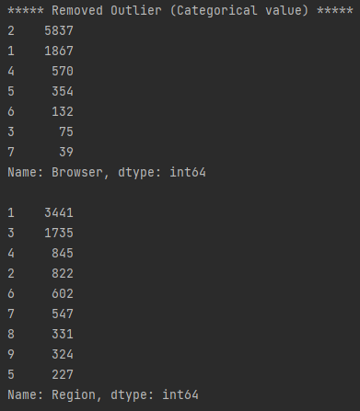
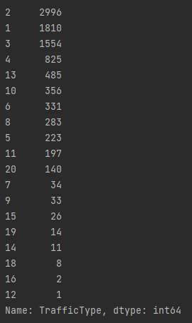
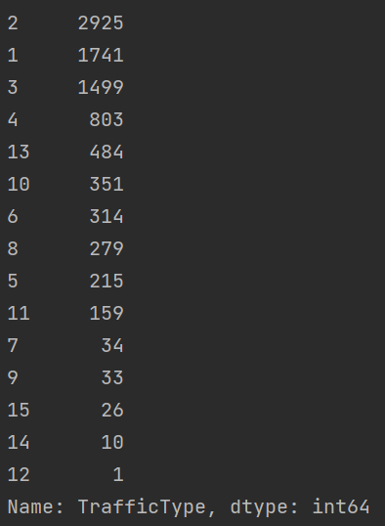
Data Preprocessing
2. Outlier detection -
Using the Z-score and check (categorical)
Browser, Region, TrafficType, VisitorType,
Weekend, OperatingSystems, Month, Revenue(Target)
Notes:
Plot 사용해야할 듯

Slide 24
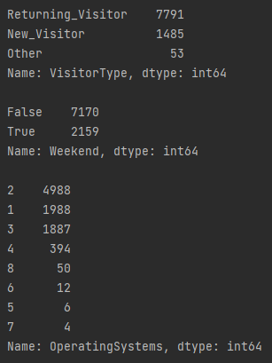
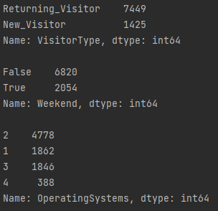
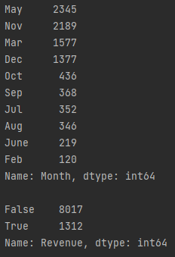
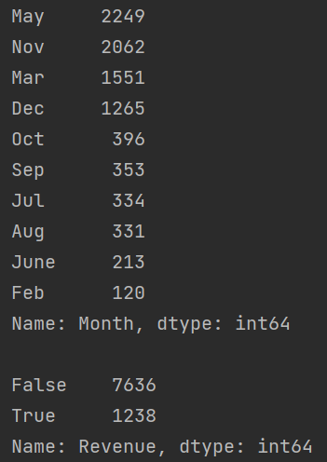
Data Preprocessing
2. Outlier detection -
Using the Z-score and check (categorical)
Browser, Region, TrafficType, VisitorType,
Weekend, OperatingSystems, Month, Revenue(Target)
Notes:
Plot 사용해야할 듯

Slide 25
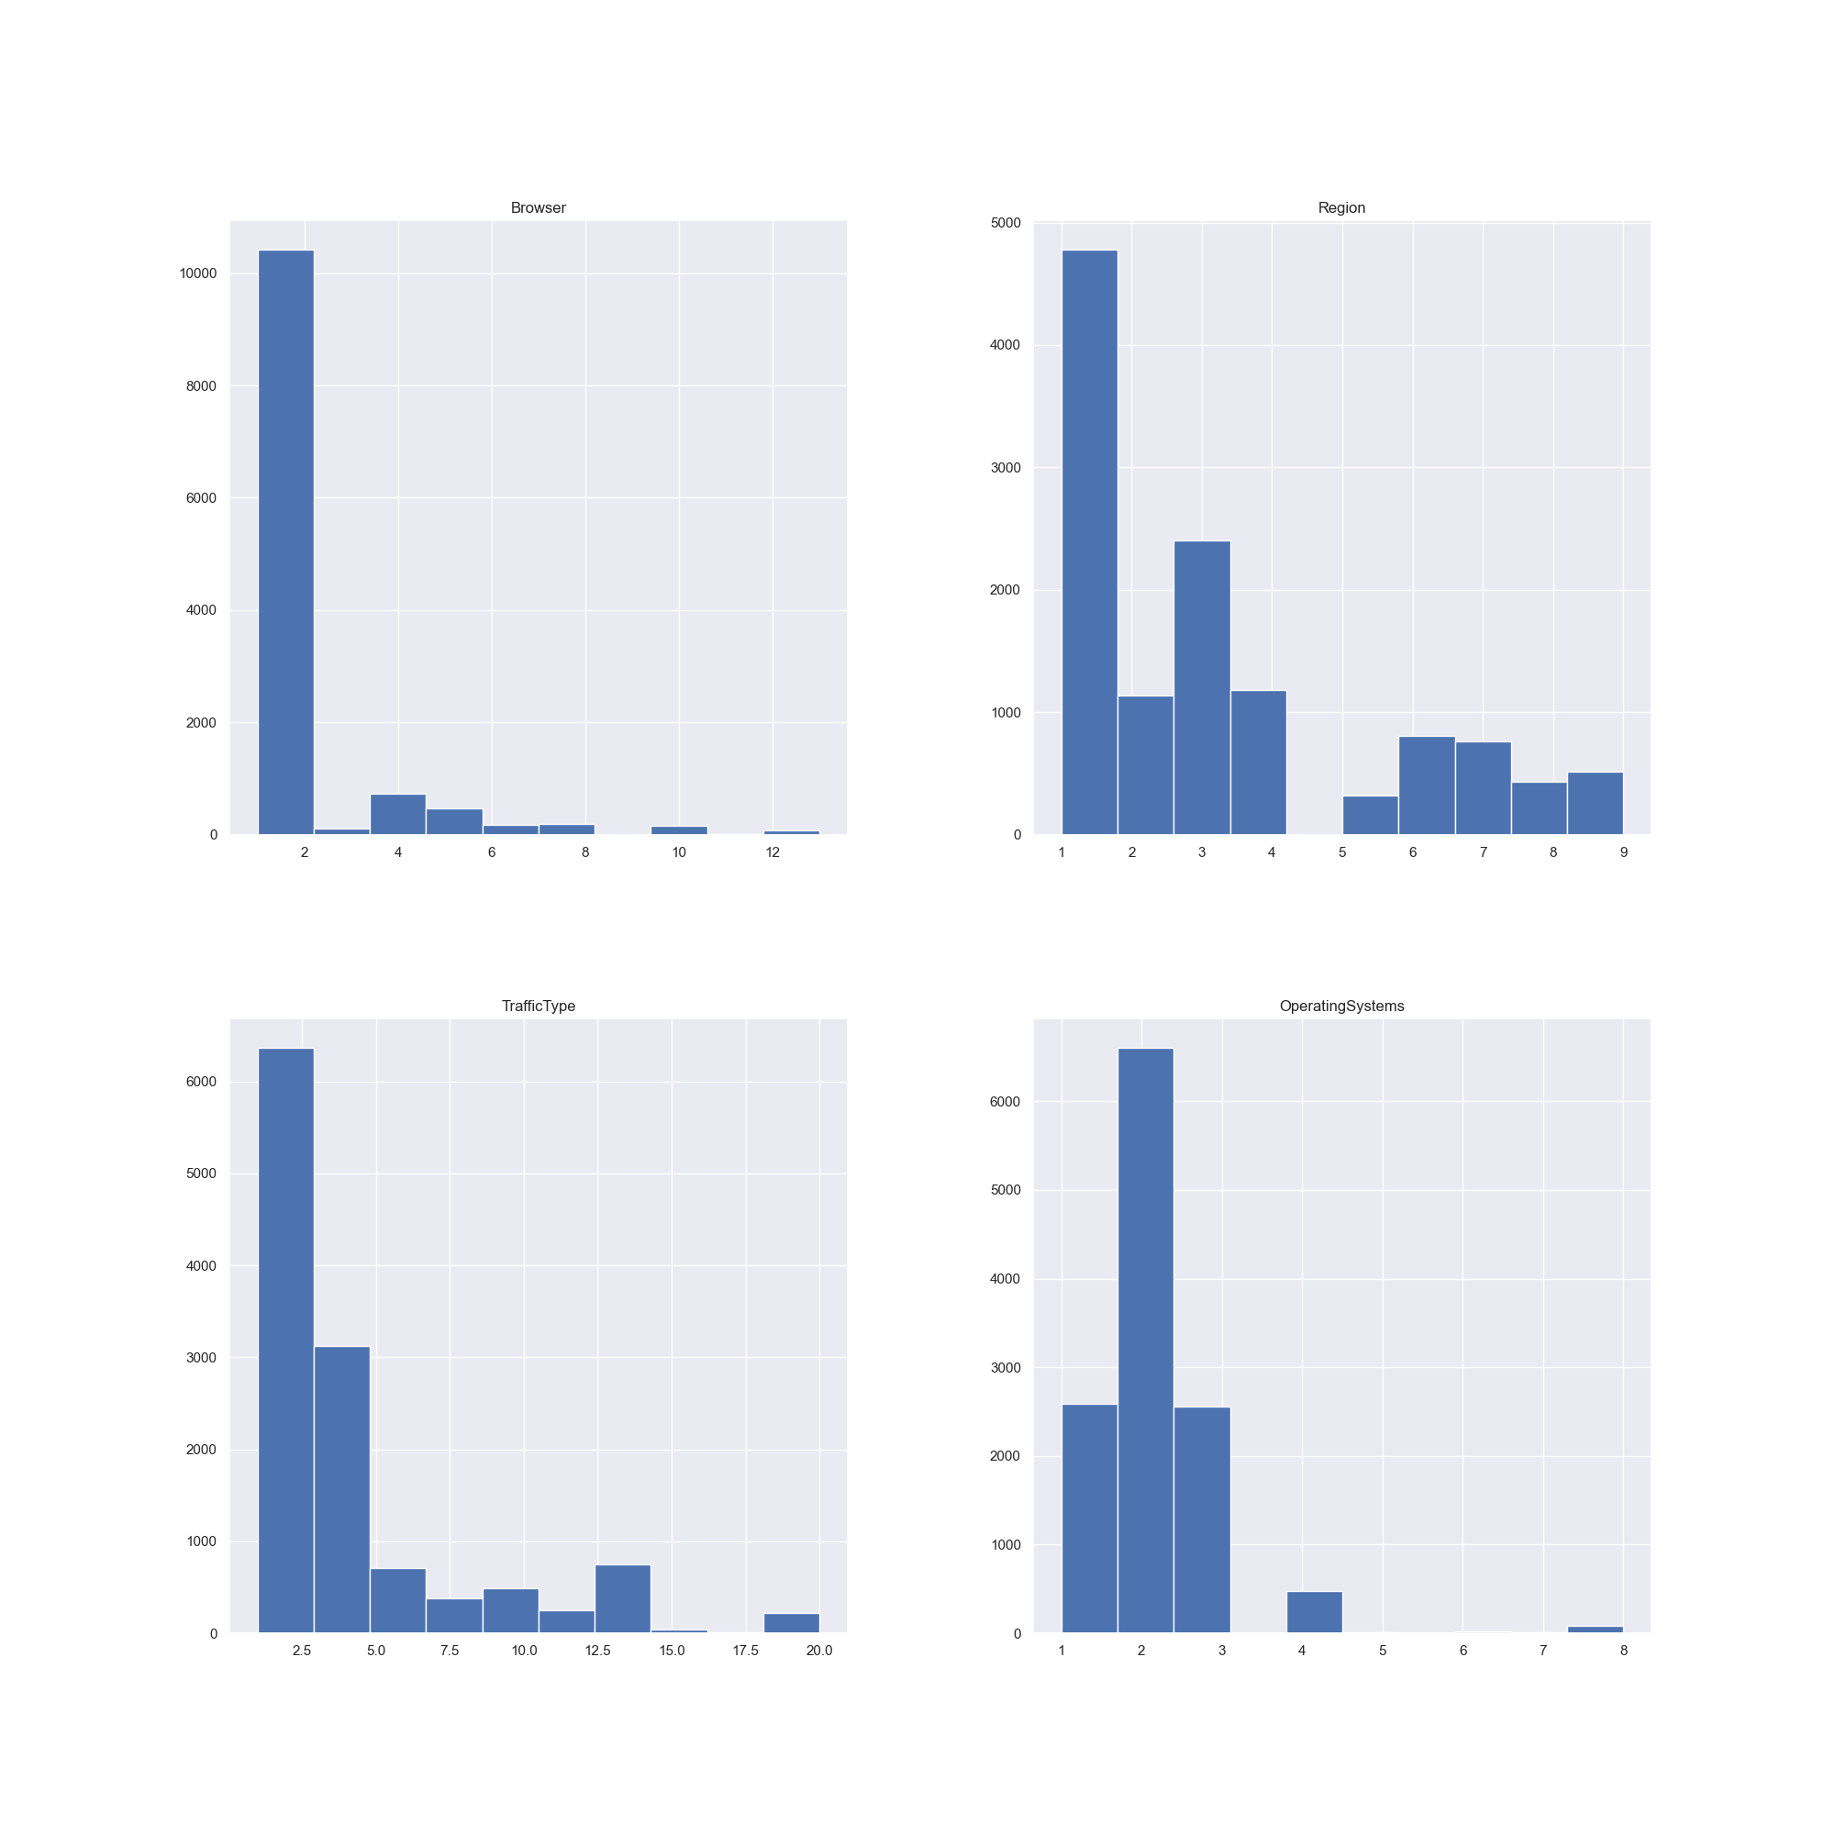
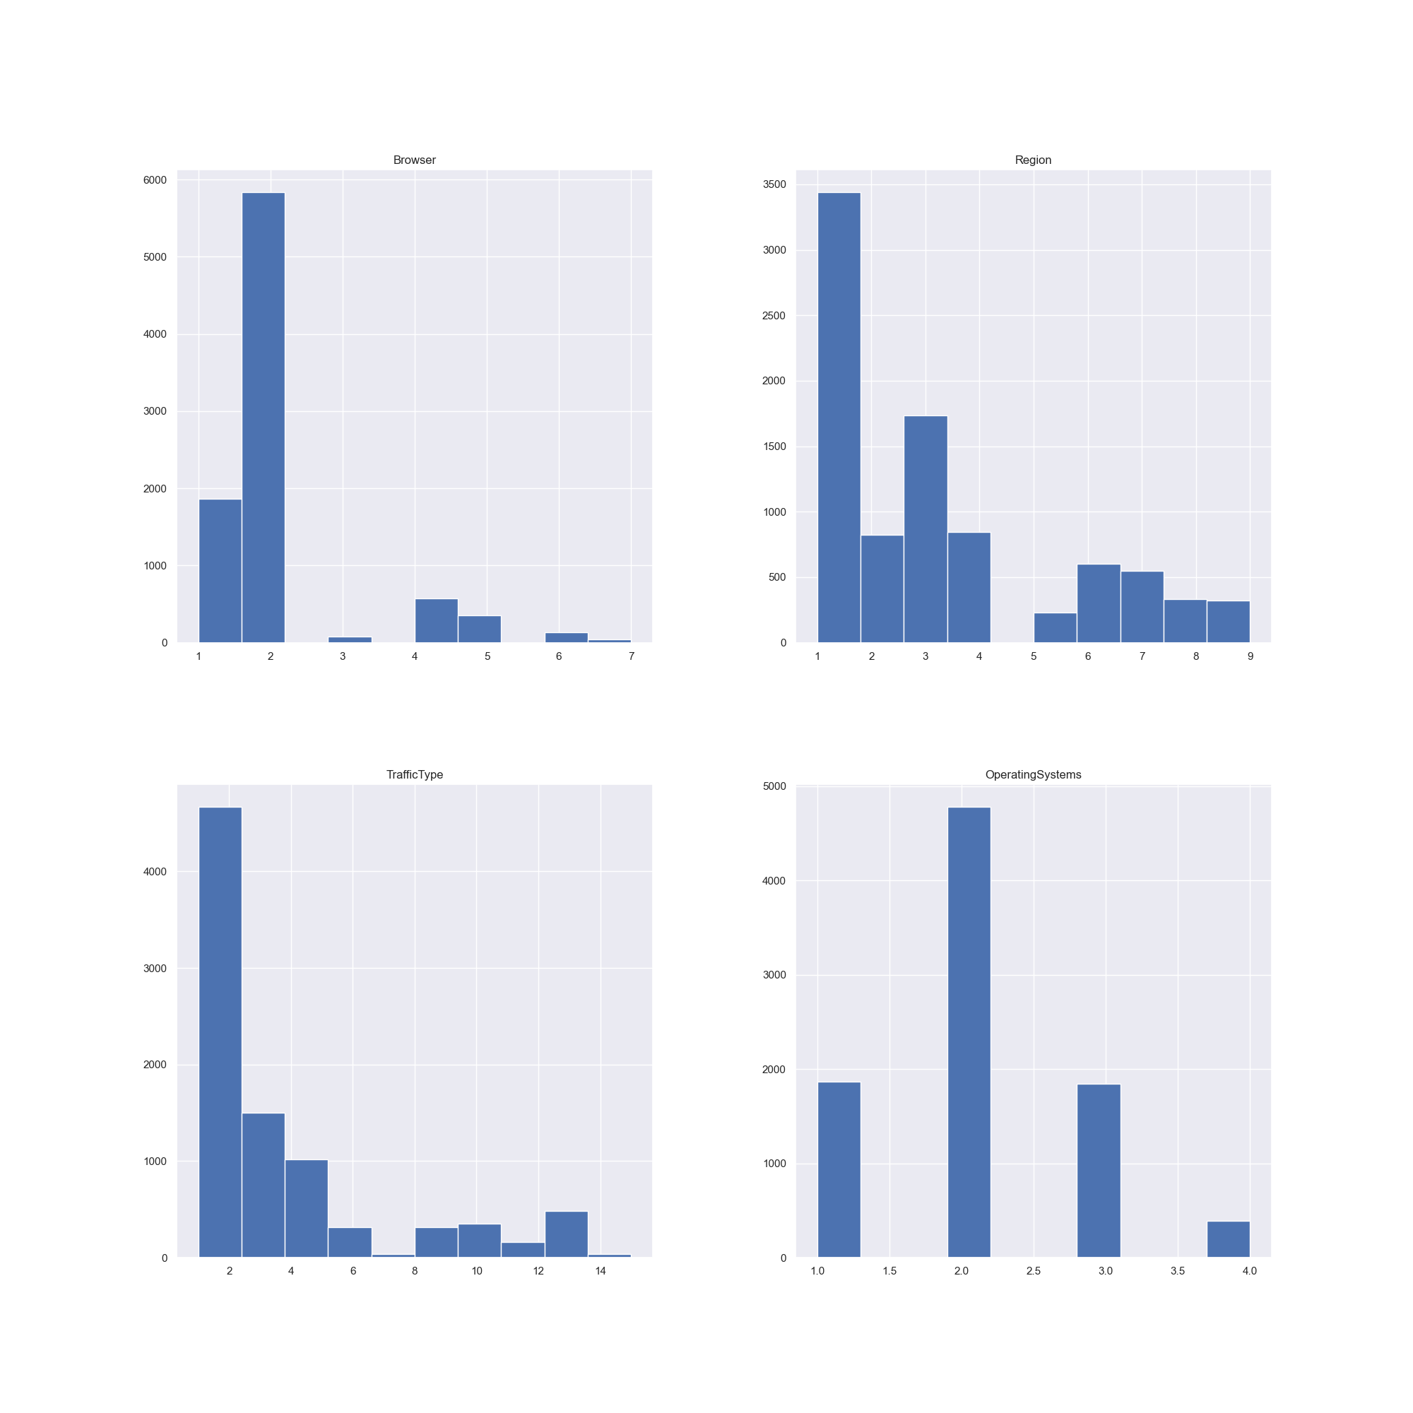
Data Preprocessing
2. Outlier detection -
Using the Z-score and check (categorical)
Notes:
Plot 사용해야할 듯

Slide 26
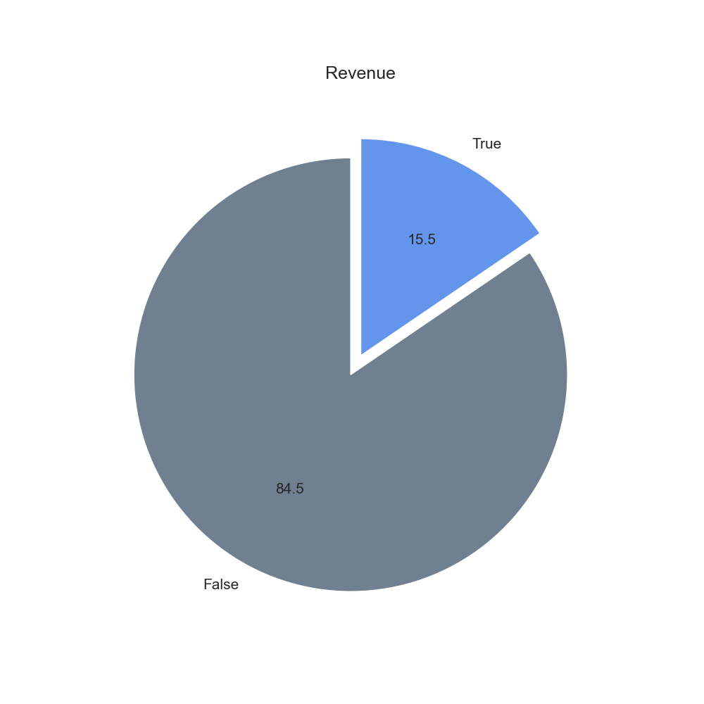
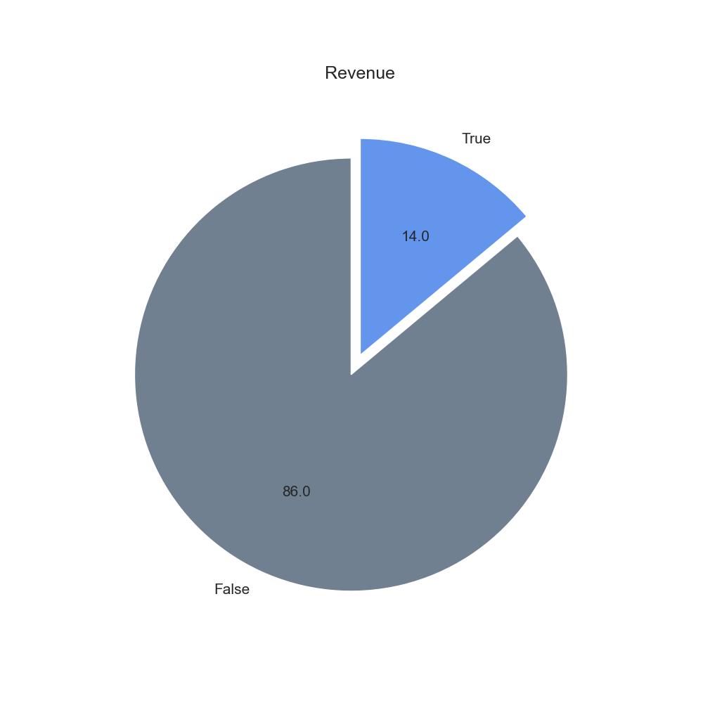
Data Preprocessing
2. Outlier detection -
Target Value
Notes:
Plot 사용해야할 듯

Slide 27
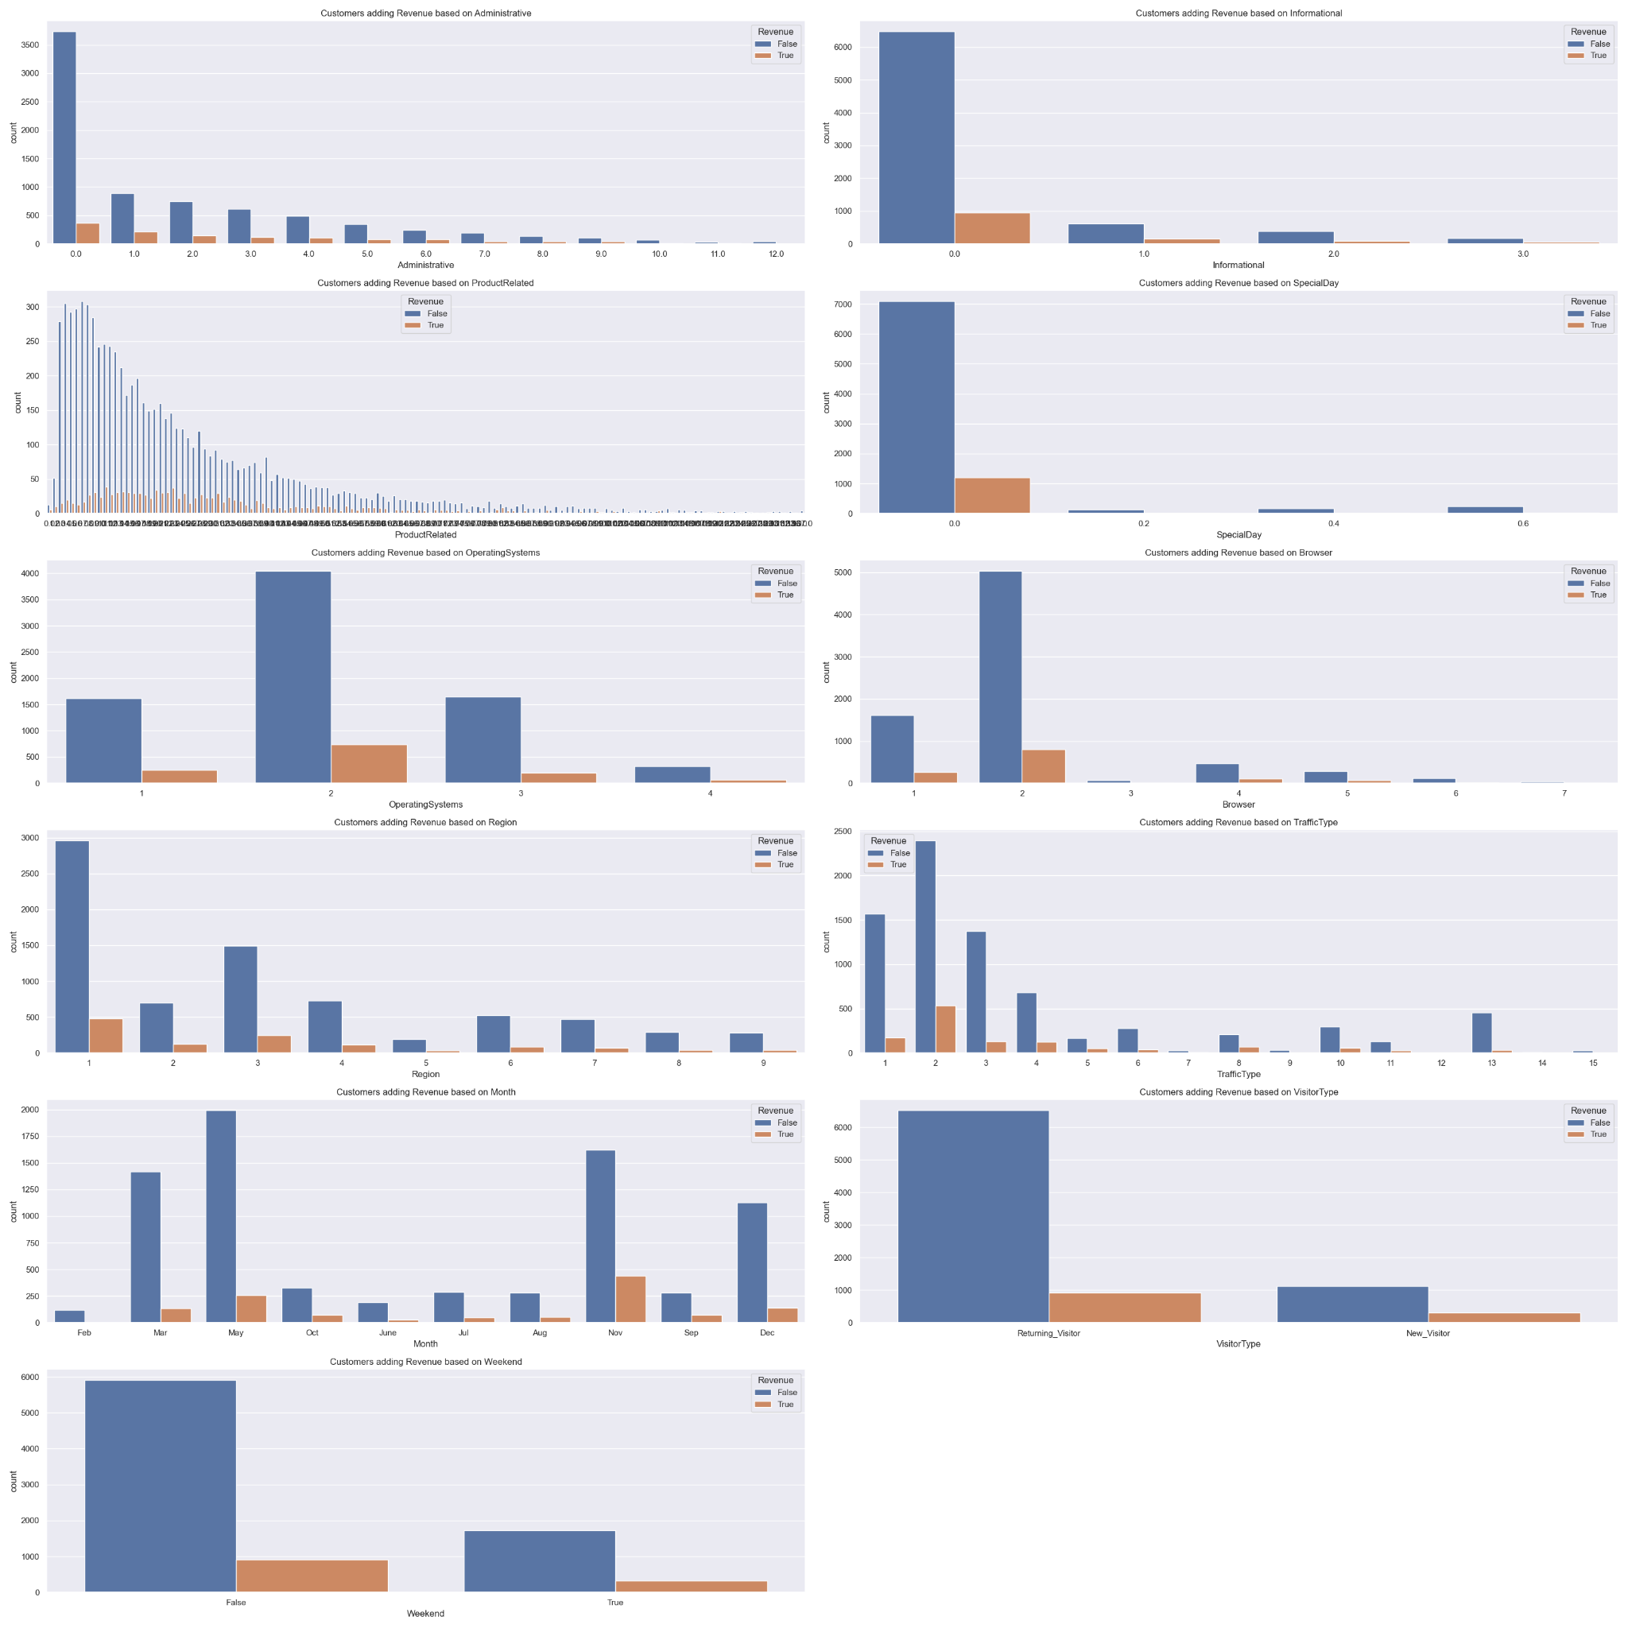
Data Preprocessing
2. Outlier detection -
Target Value
Target ratio
Feature plot
Notes:
Plot 사용해야할 듯

Slide 28
Data Preprocessing
3.Data Encoding -
Using Ordinal, Label Encoding
4.Data Scaling –
Using Standard, MinMax, MaxAbs, Robust

Slide 29
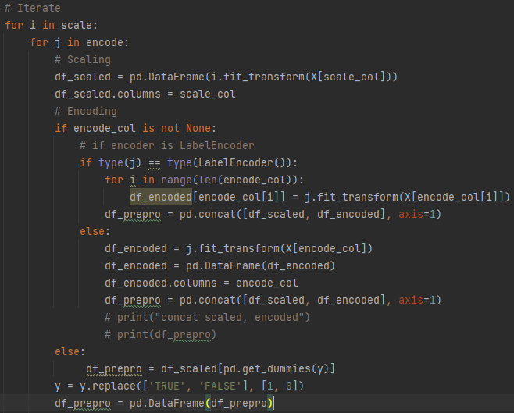
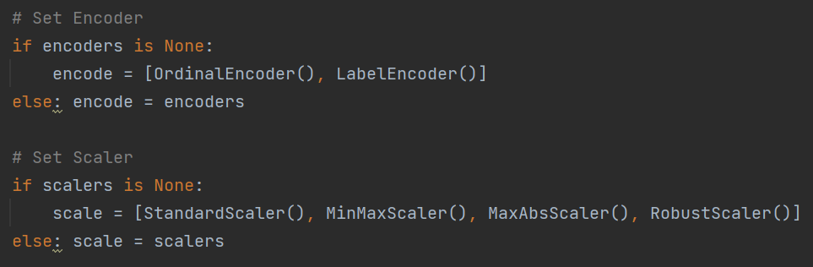
Data Preprocessing
3. Data Encoding and Scaling
Notes:
Plot 사용해야할 듯

Slide 30
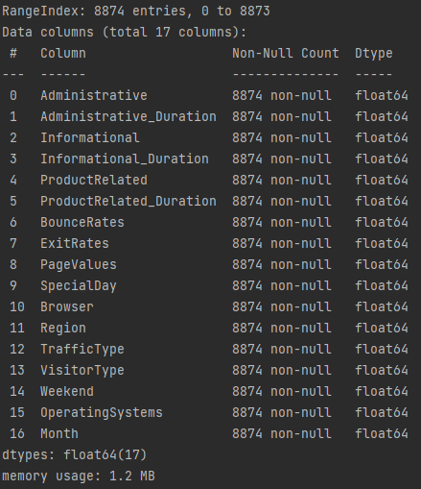
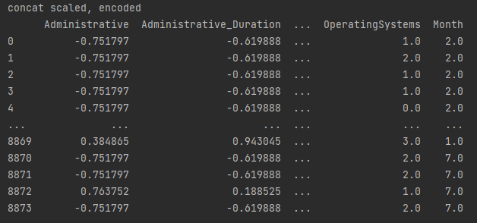
Data Preprocessing
3. Data Encoding and Scaling
Notes:
Plot 사용해야할 듯

Slide 31
Feature selection
Classification -
Using the SelectKBest,
RFE(recursive feature elimination)

Slide 32
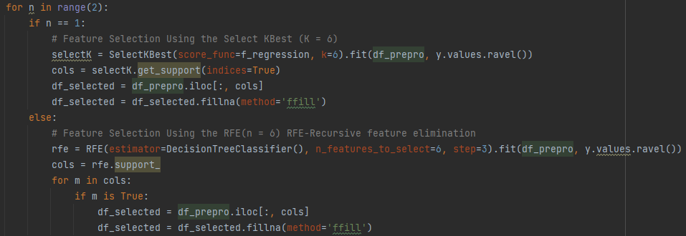
Data Preprocessing
Feature Selection - In Classification
Using KBest and RFE - K = 6
Notes:
Plot 사용해야할 듯

Slide 33
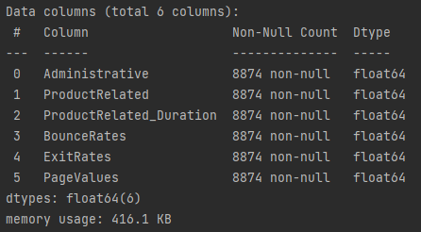
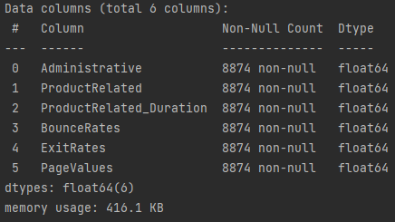
Data Preprocessing
Feature Selection - In Classification
Using KBest and RFE - K = 6
Select K Best
RFE - Recursive feature elimination
Notes:
Plot 사용해야할 듯

Slide 34
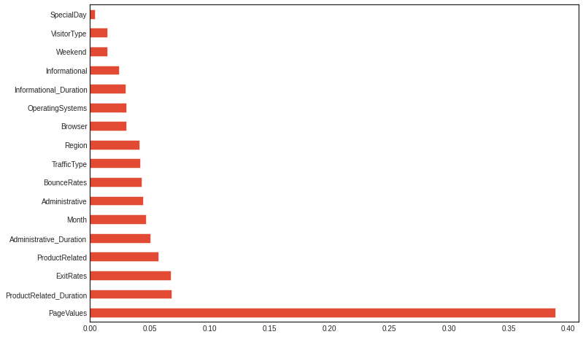
Data Preprocessing
Feature Selection - In Classification
Using KBest and RFE - K = 6
Plot - ExtraTreeClassifier
Notes:
Plot 사용해야할 듯

Slide 35
Re-weight The unbalanced Target data
Re-weight the unbalanced Target Data
The ratio of target data is 84.5% -
Negative (10,422), Positive (1908)
Using the SMOTE re-weight positive value
(Synthetic minority oversampling technique)

Slide 36
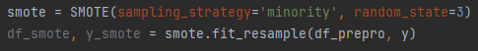
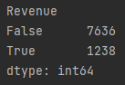
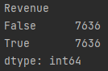
Data Preprocessing
In Classification - Must to do SMOTE at unbalanced dataset
Notes:
Plot 사용해야할 듯

Slide 37
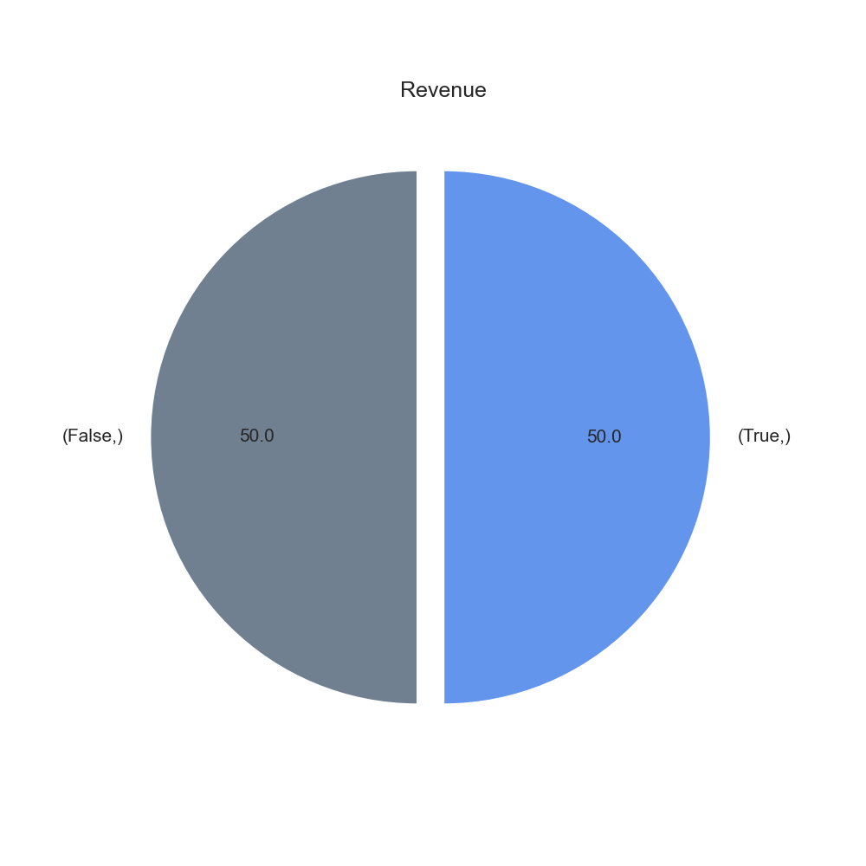
Data Preprocessing
In Classification - Must to do SMOTE at unbalanced dataset
Notes:
Plot 사용해야할 듯

Slide 38
04
Algorithm
Classification & clustering algorithm and it’s features

Slide 39
Classification
Algorithms for classification
Logistic Regression
2. Gradient Boosting Classifier
3. SVM(Support Vector Machine)

Slide 40
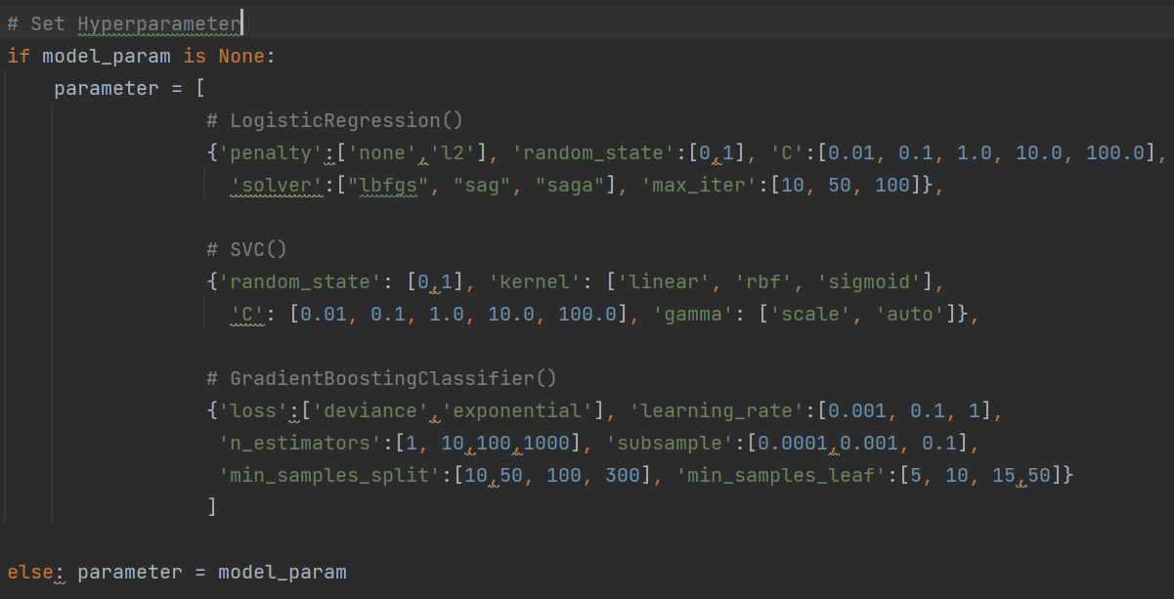
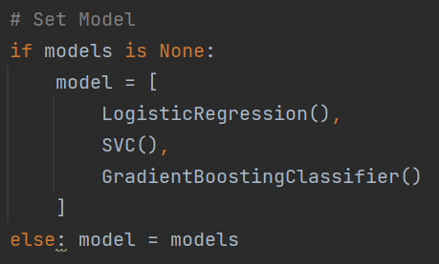
Classification
Algorithm for Classification
Model Parameter
Model
Notes:
Plot 사용해야할 듯

Slide 41
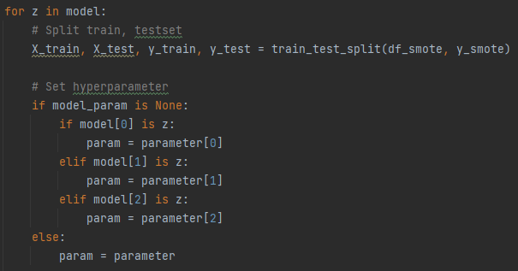
Classification
Algorithm for Classification
Model
Notes:
Plot 사용해야할 듯

Slide 42
Classification
Influential feature list for classification (Expectation)
: BounceRates, ExitRates, PageValues, VisitorType
BounceRates - Percentage of users leaving without moving to other pages
ExitRates - Percentage of customers leaving the site after moving several pages
PageValues - Average value of the page they visited before completing e-commerce
VisitorType - Whether to reconnect
All four features are information such as whether the visitor revisited or stayed on the page. So, we expect these features to have the most influence on classification.

Slide 43
Classification
Influential feature list for classification (Expectation)
: BounceRates, ExitRates, PageValues, VisitorType
Notes:
Plot 사용해야할 듯

Slide 44
05
Evaluation
Evaluate the result

Slide 45
Evaluation - AutoML
To implement with AutoML,
Continuous tuning of the parameter,
It was implemented repeatedly until
the accuracy had an appropriate value.
Notes:
Clustering 부분에
3단계로 나눠서 한다는걸 따로 얘기해주면 좋겠습니다.

Slide 46
Evaluation
Classification -
Using the Randomized Search, Cross
Validation, Precision, Recall, avg_total
Scores to select the best model.
Notes:
Clustering 부분에
3단계로 나눠서 한다는걸 따로 얘기해주면 좋겠습니다.

Slide 47
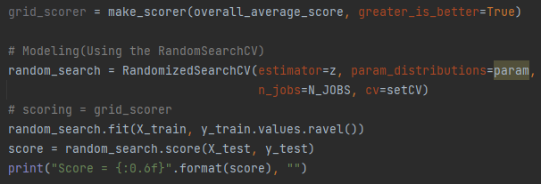
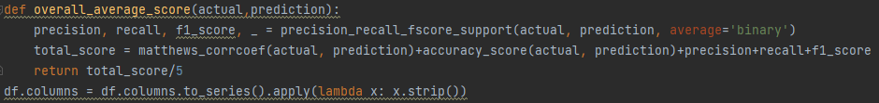
Classification
Evaluation for Classification
Using RandomizedSearchCV
Scoring function
Accuracy + Precision + recall + f1_score
Notes:
Plot 사용해야할 듯

Slide 48
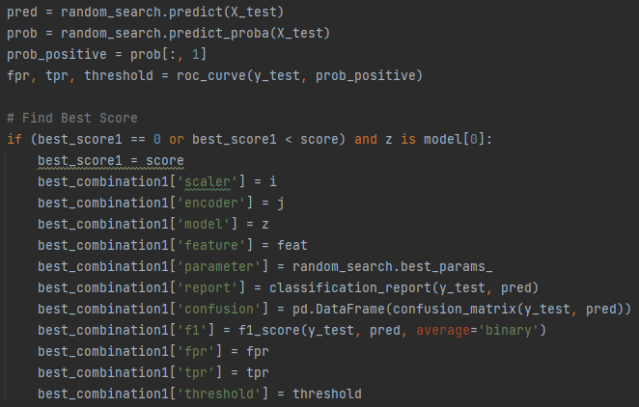
Classification
Evaluation for Classification
Using RandomizedSearchCV & Find Best Score Each model
Notes:
Plot 사용해야할 듯

Slide 49
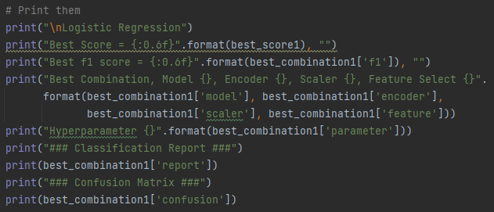
Classification
Evaluation for Classification
Using RandomizedSearchCV & Find Best Score Each model
Notes:
Plot 사용해야할 듯

Slide 50
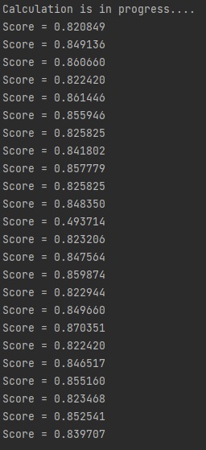
Classification
Find Best Score Each model
Auto Machine Learning
in progress (Parameter tuning)
Notes:
Plot 사용해야할 듯

Slide 51



Classification
Evaluation - Logistic Regression
Notes:
Plot 사용해야할 듯

Slide 52



Classification
Evaluation - SVM
Notes:
Plot 사용해야할 듯

Slide 53


Classification
Evaluation - GradientBoosting Classifier
Notes:
Plot 사용해야할 듯

Slide 54

Classification
Evaluation - ROC Curve
Notes:
Plot 사용해야할 듯

Slide 55

Classification
Evaluation - ROC Curve
Notes:
Plot 사용해야할 듯

Slide 56
Clustering
Clustering After
Feature Selection

Slide 57
Feature selection
Clustering -
Using the PCA, Feature random select,
The combination that we set up

Slide 58


Data Preprocessing
Feature Selection - In Clustering
Using the PCA, feature random select, and the custom select
Feature Random Select
Feature Custom Select
Notes:
Plot 사용해야할 듯

Slide 59


Data Preprocessing
Feature Selection - In Clustering
Using the PCA, feature random select, and the custom select
PCA
Feature Select (in AutoML)
Notes:
Plot 사용해야할 듯

Slide 60
04
Algorithm
Classification & clustering algorithm and it’s features

Slide 61
Clustering
Algorithms for clustering
Mean Shift (Active Learning)
2. KMeans
3. GMM (Gaussian Mixture Model) - EM

Slide 62


Clustering Algorithm
Algorithm - MeanShift, KMeans, GMM
Model Parameter
Model
Notes:
Plot 사용해야할 듯

Slide 63
05
Evaluation
Evaluate the result

Slide 64
Evaluation - AutoML
To implement with AutoML,
Continuous tuning of the parameter,
It was implemented repeatedly until
the accuracy had an appropriate value.
Especially, we focused on the step 1.
Notes:
Clustering 부분에
3단계로 나눠서 한다는걸 따로 얘기해주면 좋겠습니다.

Slide 65
Evaluation
Clustering - Three-step evaluation process.
Comparing using the silhouette score.
(feature select) * (model) = 3 * 3 = 9
2. Compare it once more using the purity score
to select the best model.
(model) = 3
3. Finally, visualize using some plot for each model.
Notes:
Clustering 부분에
3단계로 나눠서 한다는걸 따로 얘기해주면 좋겠습니다.

Slide 66

Clustering Evaluation
Step1 - Comparing using the silhouette score.
(feature select) * (model) = 3 * 3 = 9
Notes:
Plot 사용해야할 듯

Slide 67

Clustering Evaluation
Step1 - Comparing using the silhouette score.
(feature select) * (model) = 3 * 3 = 9
In function
Notes:
Plot 사용해야할 듯

Slide 68

Clustering Evaluation
Step1 - Comparing using the silhouette score.
(feature select) * (model) = 3 * 3 = 9
In function
Notes:
Plot 사용해야할 듯

Slide 69

Clustering Evaluation
Step2 - Compare it once more using
the purity score to select the best model.
(model) = 3
Notes:
Plot 사용해야할 듯

Slide 70

Clustering Evaluation
Step2 - Compare it once more using
the purity score to select the best model.
(model) = 3
In function
Notes:
Plot 사용해야할 듯

Slide 71

Clustering Evaluation
Step2 - Compare it once more using
the purity score to select the best model.
(model) = 3
In function
Notes:
Plot 사용해야할 듯

Slide 72


Clustering Evaluation
Step3 - visualize using some plot for each model.
In function
Notes:
Plot 사용해야할 듯

Slide 73



Clustering Evaluation
Auto ML Find Best Clustering - In progress (Auto Parameter Tuning)
Notes:
Plot 사용해야할 듯

Slide 74



Clustering Evaluation
Step1 - Comparing using the silhouette score.
(feature select) * (model) = 3 * 3 = 9
PCA (3, 4, 5)
KMeans
EM(GMM)
MeanShift
Notes:
Plot 사용해야할 듯

Slide 75



Clustering Evaluation
Step1 - Comparing using the silhouette score.
(feature select) * (model) = 3 * 3 = 9
RandomSelect
KMeans
EM(GMM)
MeanShift
Notes:
Plot 사용해야할 듯

Slide 76



Clustering Evaluation
Step1 - Comparing using the silhouette score.
(feature select) * (model) = 3 * 3 = 9
CustomSelect
KMeans
EM(GMM)
MeanShift
Notes:
Plot 사용해야할 듯

Slide 77

Clustering Evaluation
Step2 - Compare it once more using
the purity score to select the best model.
(model) = 3
KMeans + PCA
Notes:
Plot 사용해야할 듯

Slide 78

Clustering Evaluation
Step2 - Compare it once more using
the purity score to select the best model.
(model) = 3
EM(GMM) + PCA
Notes:
Plot 사용해야할 듯

Slide 79

Clustering Evaluation
Step2 - Compare it once more using
the purity score to select the best model.
(model) = 3
MeanShift + RandomSelect
Notes:
Plot 사용해야할 듯

Slide 80

Clustering Evaluation
Step3 - visualize using some plot for each model.
KMeans + PCA
Notes:
Plot 사용해야할 듯

Slide 81


Clustering Evaluation
Step3 - visualize using some plot for each model.
KMeans + PCA
Notes:
Plot 사용해야할 듯

Slide 82

Clustering Evaluation
Step3 - visualize using some plot for each model.
EM(GMM) + PCA
Notes:
Plot 사용해야할 듯

Slide 83


Clustering Evaluation
Step3 - visualize using some plot for each model.
EM(GMM) + PCA
Notes:
Plot 사용해야할 듯

Slide 84

Clustering Evaluation
Step3 - visualize using some plot for each model.
MeanShift + RandomSelect
Notes:
Plot 사용해야할 듯

Slide 85

Clustering Evaluation
Step3 - visualize using some plot for each model.
MeanShift + RandomSelect
Notes:
Plot 사용해야할 듯

Slide 86
Conclusion
As a result of conducting both classification and clustering,
It was confirmed that gradient bossting had the best performance in classification, and EM had the best performance in clustering.
When analyzing the results, It was confirmed that customers who visit multiple pages once accessed rather than revisiting the site also had a higher actual purchase rate.
Notes:
classification과 clustering을 모두 진행해본 결과 classification에서는 gradient boosting의 성능이 가장 좋았고, clustering에서는 EM의 성능이 가장 좋은 것으로 확인 되었다. 결과를 분석해 보았을때 사이트의 재방문 보다는 한번 접속했을때 여러 페이지를 방문하는 고객이 실제 구매율 역시 높은 것으로 확인 되었습니다.

Slide 87

Member Role
201636471 심우석
201835486 이민서
201935006 고효진
Contribution -
Role -
Data Preprocessing (cleaning dirty data, outlier detection)
Model Building (clustering)
AutoML
Final PPT
Contribution -
Role -
Model Building (classification)
Evaluation for classification
AutoML
Final PPT
Contribution -
Role -
Data Preprocessing (data encoding, data scaling)
Evaluation for clustering
AutoML
Final PPT

Slide 88
Review
The process of learning new algorithms and using them based on the concepts learned in data science was very meaningful.
And it was a meaningful process because the results seemed to have come out as intended
심우석
By applying the big data process to specific business case, we could have time to analyze the factors affecting sales, so I could know the overall flow of big data. It was meaningful to be able to apply the algorithms learned in machine learning for the purpose we actually want.
이민서
Running AutoML in various combinations, I found that it has a great influence on how accurate predictions can be made depending on how parameters and preprocessing are selected, not just algorithm selection.
고효진

Slide 89

Github Term Project Page
Main : https://github.com/dntjr41/MachineLearning_termProject
Wiki : https://github.com/dntjr41/MachineLearning_termProject/wiki

Slide 90
Wise Prophet
심우석, 이민서, 고효진

Slide 91
Table of contents
01
02
03
04
05
Data Description
Data Preprocessing
Statistical description of the dataset
Data preprocessing
Algorithm
Evaluation
Classification algorithm
Evaluate the results
Review
Review the Automated ML platform

Slide 92
01
Data Description
Statistical description of the dataset

Slide 93
Data Description
하나생명보험공개데이터
Unsupervised data -> clustering
It is clustered into grade 1 to 4 depending on the possibility of a loan
17 features, No target value
Data consists of customer information, subscription insurance status, and customer past patterns.

Slide 94

Data Description

Slide 95

Data Description
Numerical Value
Numerical Value
Numerical Value
Numerical Value
Categorical Value
Numerical Value
Categorical Value
Numerical Value
Numerical Value
Numerical Value
Numerical Value
Numerical Value
Numerical Value
Numerical Value
Numerical Value

Slide 96
02
Data Preprocessing
Data preprocessing

Slide 97

Data Preprocessing
We didn’t use variable that weren’t important, such as ID.
The setting was changed according to the variable type.
Since it is unsupervised data, the target value is not set.

Slide 98


Data Preprocessing
Check Outlier and Correlation for each variables

Slide 99

Data Preprocessing
Outlier detection for each variables
Remove feature with low correlation

Slide 100
03
Algorithm
Classification algorithm

Slide 101

Algorithm
Set to clustering algorithm

Slide 102

Algorithm
Set it to KMeans and set n_cluster to 4, which was initially set as the goal.

Slide 103
04
Evaluation
Evaluation the results

Slide 104

Evaluation
As a result of the cluster, it was clustered into 4 clusters.

Slide 105


Evaluation
Cluster label - 0
They belong to the elderly and have very high maturity insurance premiums.

Slide 106


Evaluation
Cluster label - 1
It can be seen that they are relatively young and have low incomes.

Slide 107


Evaluation
Cluster label - 2
They are at the age of economics activities, Also it can be seen that income and housing prices are at an middle level.

Slide 108

Evaluation
Cluster label - 3
In clusters with label of 3, it is difficult to compare because only this data exists.
We think it would be appropriate to make n_cluster 3 instead of 4
When comparing plot and data check, clustered data generally tend to be similar.
If classification was used, not clustering, the accuracy would have been known, but that part is regrettable.

Slide 109
05
Review
Review the Automated ML platform

Slide 110
Review
심우석
The machine learning process was very simple, so it was convenient.
In addition, the UI was intuitive, so it seemed to increase usability.
The speed was also very fast, so I was satisfied.
The clustering accuracy seems to be high, also I want to try the classification later.
이민서
I think it is an easy tool to access even for people who do not know machine learning well. The UI is very well-organized and not complicated, so it seems to be really helpful for those who need data analysis.
고효진
It was a good opportunity to analyze the data that we can access in our daily lives. It was also a good opportunity to think about how to combine these results to create new technologies by analyzing these actual data.

Slide 111
Thanks!
Do you have any questions?
Github - https://github.com/dntjr41/MachineLearning_termProject
201636417 심우석
201835486 이민서
201935006 고효진

